Slide 1
Linked Lists
Data Structures Using Java
1

Slide 2
Chapter Objectives
Learn about linked lists
Become aware of the basic properties of linked lists
Explore the insertion and deletion operations on linked lists
Discover how to build and manipulate a linked list
Data Structures Using Java

Slide 3
Chapter Objectives
Learn how to construct a doubly linked list
Learn about linked lists with header and trailer nodes
Become aware of circular linked lists
Data Structures Using Java

Slide 4
Linked Lists
Definition: a list of items, called nodes, in which the order of the nodes is determined by the address, called the link, stored in each node
Every node in a linked list has two components:
  one to store relevant information
  one to store address (the link) of next node in list
Data Structures Using Java

Slide 5
Linked Lists
Address of first node in list stored in separate location, called the head or first
Data type of each node depends on the specific application — kind of data being processed
link component of each node is a reference variable
Data type of this reference variable is node type itself
Data Structures Using Java

Slide 6


Linked Lists
Structure of a node
Structure of a linked list
Data Structures Using Java

Slide 7
Linked Lists: Some Properties
The address of the first node in a linked list is stored in the reference variable head
Each node has two components: one to store the info; and one to store the address of the next node
head should always point to the first node
Data Structures Using Java

Slide 8
Linked Lists: Some Properties
Linked list basic operations:
  Search the list to determine whether a particular item is in the list
  Insert an item in the list
  Delete an item from the list
Data Structures Using Java

Slide 9
Linked Lists: Some Properties
Operations require traversal of the list
Given a reference variable to the first node of the list, step through each of the nodes of the list
Traverse a list using a reference variable of the same type as head
Data Structures Using Java

Slide 10
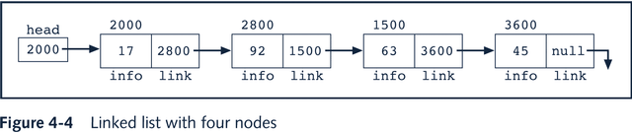
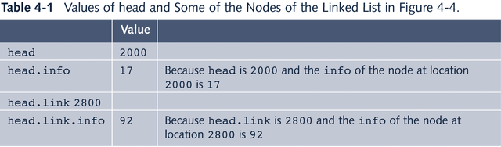
Linked Lists: Some Properties
Data Structures Using Java

Slide 11
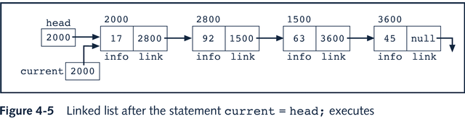
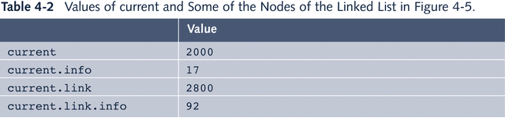
Linked Lists: Some Properties
Data Structures Using Java

Slide 12
Linked Lists: Some Properties
Data Structures Using Java

Slide 13
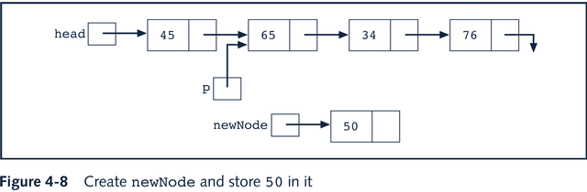
Insertion
Data Structures Using Java

Slide 14
Insertion
Code Sequence I
  newNode.link = q;
  p.link = newNode;
Code Sequence II
  p.link = newNode;
  newNode.link = q;
Data Structures Using Java

Slide 15
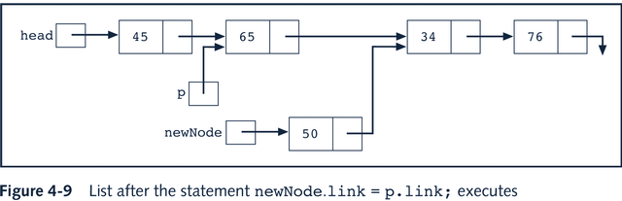
Insertion
Both code sequences produce the result shown below
Data Structures Using Java

Slide 16

Deletion
Node to be deleted is 34
Data Structures Using Java

Slide 17

Deletion
q = p.link;
p.link = q.link;
q = null;
Data Structures Using Java

Slide 18
Building a Linked List
Two ways to build a linked list:
1) forward
2) backward
Data Structures Using Java

Slide 19
Building a Linked List
What is needed to build a linked list forward:
  a reference variable for the first node
  a reference variable for the last node
  a reference variable for the new node being added
Data Structures Using Java

Slide 20
Building a Linked List
Steps to build a linked list forward:
  Create a new node called newNode
  If first is NULL, the list is empty so you can make first and last point to newNode
  If first is not NULL make last point to newNode and make last = newNode
Data Structures Using Java

Slide 21
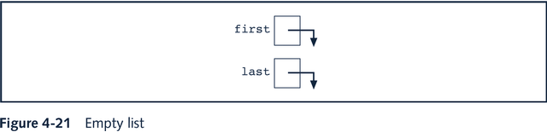

Building a Linked List Forward
Data Structures Using Java

Slide 22
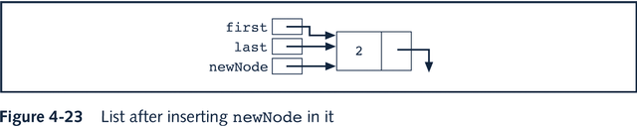
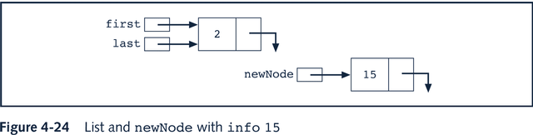
Building a Linked List Forward
Data Structures Using Java

Slide 23
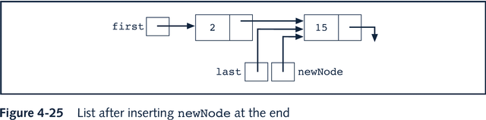
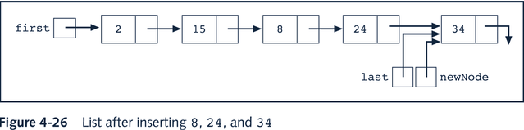
Building a Linked List Forward
Data Structures Using Java

Slide 24
Building a Linked List
What is needed to build a linked list
backwards:
  a reference variable for the first node
  a reference variable to the new node being added
Data Structures Using Java

Slide 25
Building a Linked List
Steps to build a linked list backwards:
  Create a new node newNode
  Insert newNode before first
  Update the value of the reference variable first
Data Structures Using Java

Slide 26
Linked List as an ADT
Basic operations on a linked list are:
  Initialize the list
  Check whether the list is empty
  Output the list
  Find length of list
Data Structures Using Java

Slide 27
Linked List as an ADT
Basic operations on a linked list are:
  Get info from last node
  Search for a given item
  Insert an item
  Delete an item
  Make a copy of the linked list
Data Structures Using Java

Slide 28
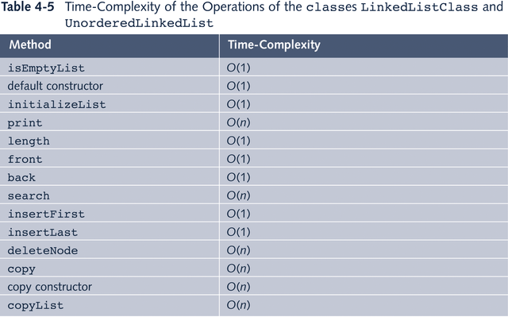
Time-Complexity of Operations
Data Structures Using Java

Slide 29
Ordered Linked List
In an ordered linked list the elements are sorted
Because the list is ordered, we need to modify the algorithms (from how they were implemented for the regular linked list) for the search, insert, and delete operations
Data Structures Using Java

Slide 30
Doubly Linked List
Every node:
  has a next reference variable and a back reference variable
  (except the last node) contains the address of the next node
  (except the first node) contains the address of the previous node
Can be traversed in either direction
Data Structures Using Java

Slide 31
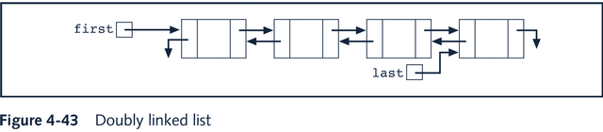
Doubly Linked List
Data Structures Using Java

Slide 32
Linked Lists with Header and Trailer Nodes
Simplify insertion and deletion by never inserting an item before first or after last item and never deleting first node
Set a header node at the beginning of the list containing a value smaller than the smallest value in the data set
Set a trailer node at the end of the list containing a value larger than the largest value in the data set
Data Structures Using Java

Slide 33
Linked Lists with Header and Trailer Nodes
These two nodes, header and trailer, serve merely to simplify the insertion and deletion algorithms and are not part of the actual list.
The actual list is between these two nodes.
Data Structures Using Java

Slide 34
Circular Linked List
A linked list in which the last node points to the first node is called a circular linked list
In a circular linked list with more than one node, it is convenient to make the reference variable first point to the last node of the list
Data Structures Using Java

Slide 35
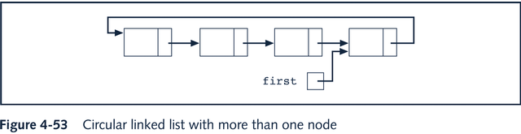
Circular Linked List
Data Structures Using Java

Slide 36
Programming Example: Video Store
For a family or an individual, a favorite place to go on weekends or holidays is to a video store to rent movies. A new video store in your neighborhood is about to open. However, it does not have a program to keep track of its videos and customers. The store managers want someone to write a program for their system so that the video store can function. The program should be able to perform the following operations:
    1. Rent a video; that is, check out a video.
    2. Return, or check in, a video.
    3. Create a list of videos owned by the store.
    4. Show the details of a particular video.
    5. Print a list of all the videos in the store.
    6. Check whether a particular video is in the store.
    7. Maintain a customer database.
    8. Print a list of all the videos rented by each customer.
Data Structures Using Java

Slide 37
Chapter Summary
Linked Lists
  Traversal
  Searching
  Inserting
  deleting
Building a linked list forwards
Building a linked list backwards
Data Structures Using Java

Slide 38
Chapter Summary
Ordered Linked Lists
Doubly Linked Lists
Linked lists with header and trailer nodes
Circular linked lists
Data Structures Using Java

